Slide 1
SECURITY – OWNERS PERSPECTIVE
MIEVOM 29TH NOVEMBER 2018

Slide 2
OUR BUSINESS
CHEMICALS
BUSINESS UNITS
OIL
LOGISTICS
DRY BULK
SHIP MGMT
Bahri
Oil
Bahri
Chemicals
Bahri
Logistics
Bahri
Dry Bulk
Bahri
Ship Management

Slide 3
Who we are Our fleet in numbers
45
VLCCs
33
Chemical & Product
Tankers
6
RoCon
Vessels
5
Dry Bulk
Vessels
3 MORE CHEMICAL TANKERS IN 2019 & 4 DRY BULK VESSELS IN 2020

Slide 4
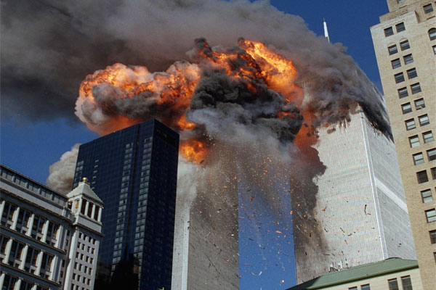
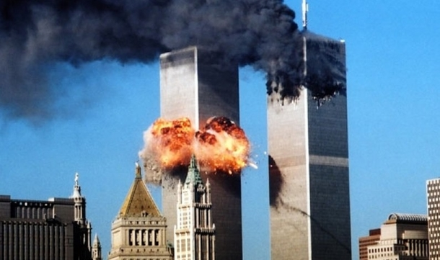
9/11

Slide 5
ISPS CODE
While Maritime security was on the agenda of IMO since the Achille Lauro hijacking in 1985, the tragic events of 9/11 raised question of vulnerability of ships being used as a vector for terrorist activity
December 2002 – ISPS code was fast tracked and added to SOLAS
1st July 2004 – came into force

Slide 6
SITUATION PRE ISPS CODE
No systematic approach to security by most Companies
Seafarers more or less left to themselves to address security issues
No requirement for a CSO or a security department
Back in the 1990’s Malacca / Singapore straits was a dangerous area. Ships didn’t have means to protect themselves – razor wires etc.
Similar state in other hot spots

Slide 7
BENEFITS
THE ISPS CODE CHANGED ALL THAT
Being mandatory, compelled Owners to invest substantially in security
Brought security to the forefront with equal weightage as all other Ship Management activities
Led to better awareness among seafarers
Led to better coordination and understanding between Merchant Shipping and Military forces
Also encouraged other security initiatives such as Industry led BMP to address Piracy not addressed in the code.

Slide 8
ISPS CODE – KEY POINTS
Mandatory requirement of Ship Security Plan approved by Flag State
Mandatory ship specific Security Assessment of vessel and her trading area before being put in service
Ships required to have an alert system to alert shore office of a security threat
Established different security levels to address different levels of security threat.
Requirement of security drills
Crew training
New positions of Company Security officer and Ship Security officer

Slide 9
KEY POINTS
The Code also required Ports catering to ships on International trade to have their own security plan and a Port Facility Security Officer (PFSO)

Slide 10
OUR EXPERIENCE
Security was always complex, but it has become more complex in recent years
ISIS scare in Mediterranean, AQAP in GOA / BAM Straits, Abu Sayyaf, Boko Haram, Rohingya refugees in Andaman seas…the list goes on
Being a Saudi Company, we face unique challenges in the Red Sea – Yemen conflict
Our Ships trade world-wide so assessment has to be as per trading pattern
New Port / New Country needs fresh assessment
Security threat is not static, as it keeps evolving in different forms
Many our ships were Saudi flagged. Until last year we could not carry armed guards
Fortunate that during worst years of Somali Piracy, none of our ships hijacked despite no armed guards
A CSO always has to be alert and keep an eye on new and emerging threats

Slide 11
OUR EXPERIENCE
HOW DO WE STAY CURRENT?
By all means off course! We have partnered with a private maritime intelligence Company to provide up to date feed on worldwide security threats
We also work closely with Flags, UKMTO, IMB, Saudi Navy and other Industry partners, forums and P&I Clubs
Feedback provided by our Ship’s Masters
It’s always important to keep track of current events in news channels and Industry news reports
We track our fleet regularly. Any aberrations in the planned passage results in the ship getting a call from the CSO.

Slide 12
OUR EXPERIENCE
Preparing our crew
Well trained and security aware crew are key to keeping our ships secure and safe
All crew and officers are trained as per STCW requirements
Comprehensive security briefing of new Masters and Chief officers before they join our vessels
Security briefing and sharing of incidents during officer’s conferences at various Manning centers
Try and have security experts talk at the seminars. We have had UKMTO and Assistant Director of IMB presenting at our conferences.
Regularly share incident reports with our vessels

Slide 13
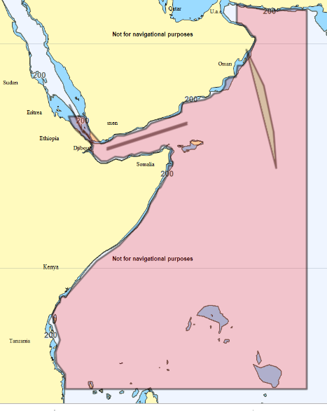
AREAS OF CONCERNS
IOR / GOA / BAM Straits and Southern Red Sea

Slide 14
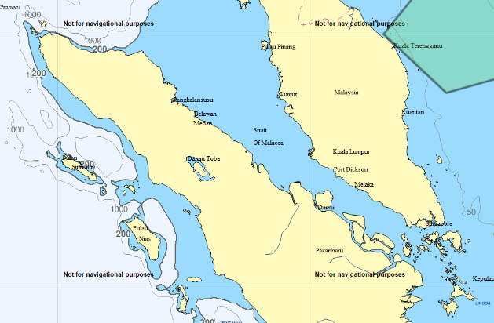
Singapore / Malacca Straits

Slide 15
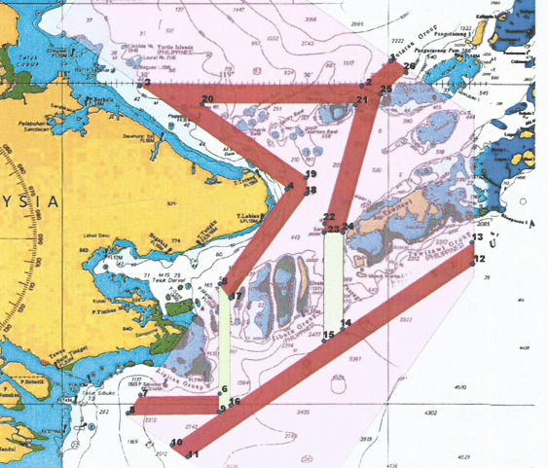
Sulu / Celebes Sea

Slide 16
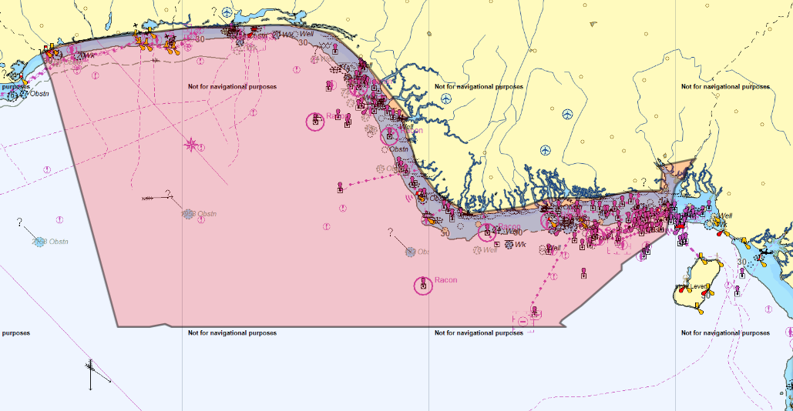
Gulf of Guinea

Slide 17
OTHER AREAS OF CONCERN
Gulf of Kutch (India)
Indonesian Waters and Ports
Venezuela
Caribbean

Slide 18
JURY AFTER 14 YEARS!
Better understanding between Merchant Shipping and Military
From IMO to Industry, there is better understanding of security threats leading to excellent initiatives such as BMP and now Global BMP
Better protective measures available for both ships and crew – Razor wires, citadel, satellite phones, protective gear etc.
Concept of having armed security on board now a reality
The World was always a dangerous place, but crew can now be assured of a more positive approach towards security
ITF rules have now given crew the option of not going to high risk area. This compels ship owners to either give the crew option to disembark or not go at all.
Though Terrorism persists all over the world, no merchant ship has been used as a vector for terrorist related activity.
Better tools available to shipping in general to assess security risk on their trade routes– Tracking websites and sites offering Maritime security intelligence
Systematic assessment has resulted in addressing other threats – stowaways, migrants at sea

Slide 19
DOWNSIDES!
Focus on security has led to criminalization of seafarers! Treated as second class citizens at some Ports. Not allowed to go ashore due to security reasons. This adversely affects the mental well being of seafarers. This is something for Port Authorities to consider
Certain Nationalities targeted
In several areas, challenging to embark / disembark crew. Crew end up staying longer when they should be with their family
In the name of security, several Ports do not permit lowering of lifeboats as required by SOLAS
Similar reason for not allowing stores boats preventing supply of essential food and other items on board.

Slide 20
DOWNSIDES!
As always, while shipping companies are expected to comply strictly with security requirements, compliance is more in the breach in a few well-known Ports.
Security is used as a tool of harassment
Threats have evolved – Drones, WBIEDS, Missile attacks!
Traditional Shipping Companies are not geared to address these new and looming threats.
As always, we will be one step behind!

Slide 21
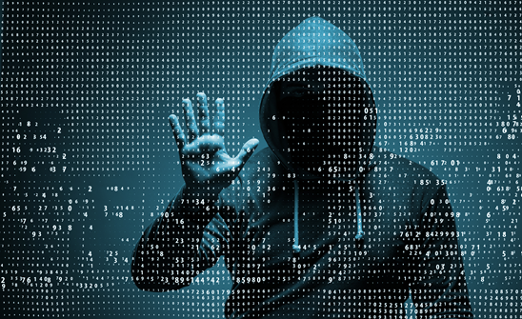
THE FUTURE
The Challenge continues ….
Next frontier - cyber security?

